Slide 1


Understanding how motivations for using iNaturalist change over time
Samantha Lowe, Brittany Mason, Dr. Nia Morales, and
Dr. Corey T. Callaghan

Slide 2
Motivations for participating in citizen science
Understanding what motivates participants can improve recruitment and maintenance of participants
People participate in projects that accommodate their motivations
Contributing to science and learning are two strong motivators for biodiversity-oriented citizen science projects
West et al., 2021; Larson et al., 2020; Asingizwe et al., 2020; Maund et al., 2020

Slide 3



What we know about how motivations change over time
Previous research hasn’t studied how motivations change through time sequentially
INITIAL
PRESENT
TIME
Motivations tend to be collectivistic
Science and conservation is an even more important motivator
Motivations tend to be egoistic
Larson et al., 2020; Bible and Clarke-De Reza, 2023

Slide 4

Addressing this knowledge gap with iNaturalist
Broad in scope based on number of users (3.2M) and diverse interests of users
Results may be applicable to other citizen science projects

Slide 5
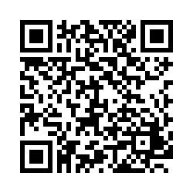
Methods
Quota Sampling of U.S. iNat users
Stratified users into 5 groups by observation count
100 users sampled per group + 2 resamples
Utilized iNat DMs
Survey Design & Pilot
15 motivations on a 5-point likert scale
Next: Convenience sampling
open to all iNat users
Notes:
Quota sampling represents today’s results.

Slide 6
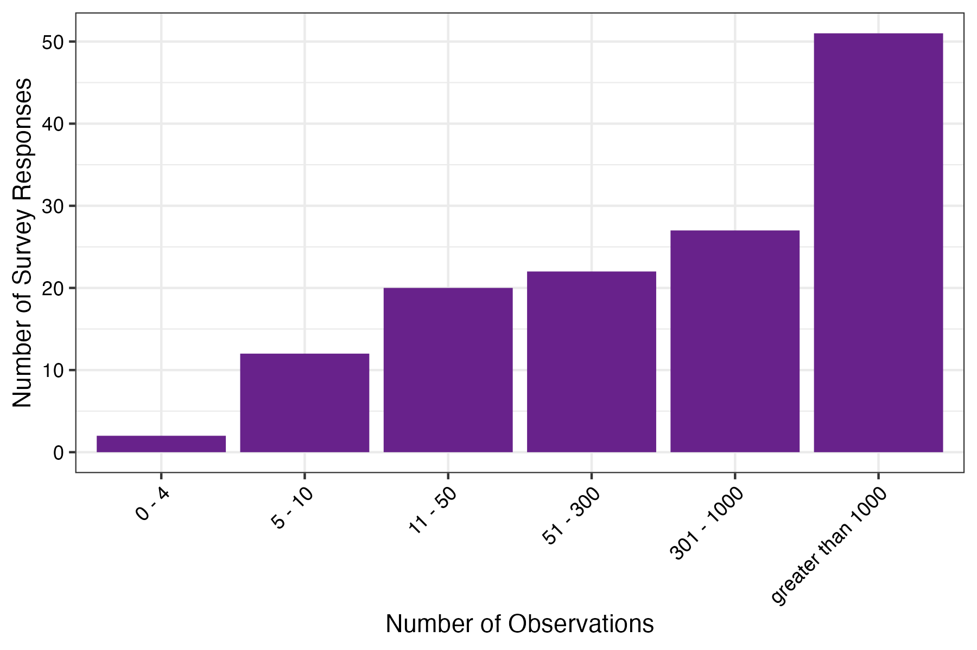

Survey is in progress!
So far…
n=138

Slide 7
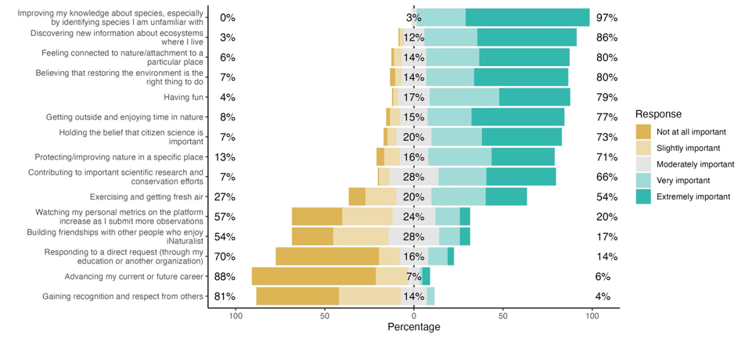

Slide 8
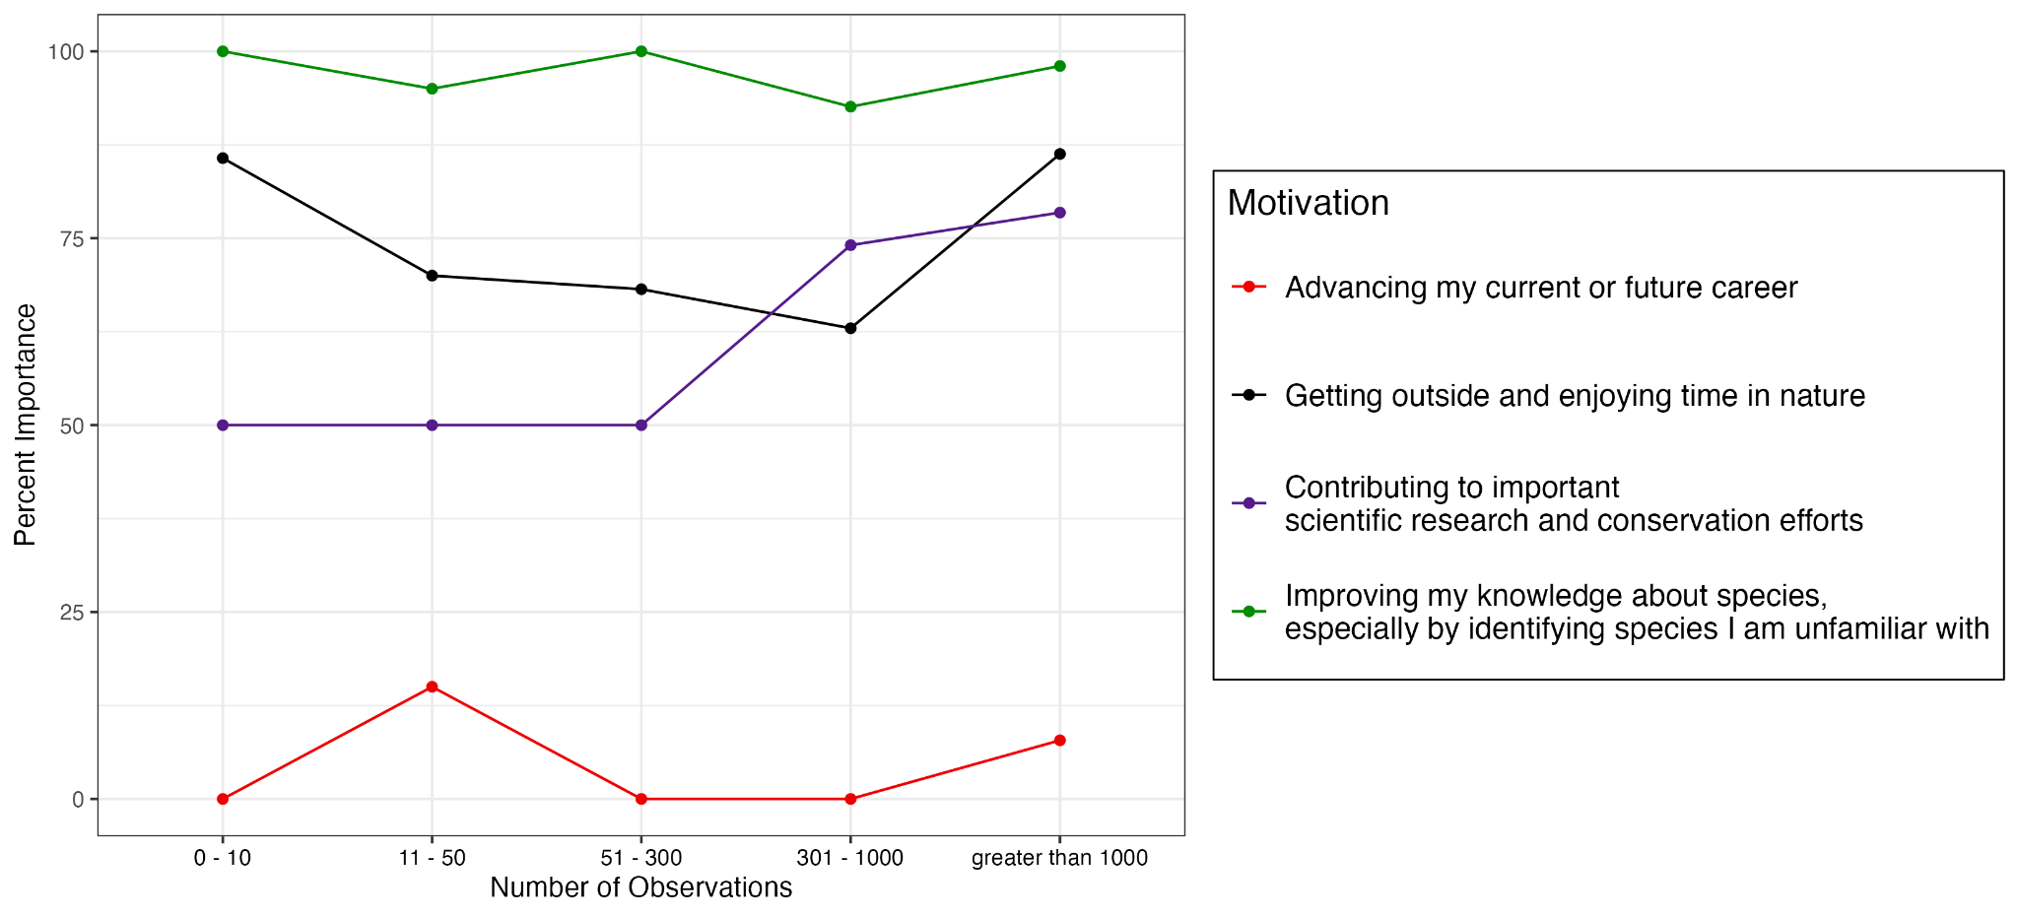
Notes:
Talk about how this is showing both teal colors from previous slides (very and extremely important = importance)

Slide 9
Key takeaways
Citizen science projects can focus on motivations consistently important for all users to both recruit and maintain participants.
Some motivations vary in importance with participant experience. Understanding this variability can inform which motivations should be emphasized when recruiting and which should be emphasized to maintain active participants.

Slide 10
Thank you!

